Slide 1
CMPE 220
Week 9 – Compilers (part 2)
Notes:
Let’s talk about history.
California State Railroad Museum – 1976 - docents worked on original steam engines.

Slide 2
Compiler Components
High Level Language Source Code (e.g. C++)
Scanner (lexical analyzer)
Tokens (types & values)
Parser (syntax analyzer)
Parse Tree (an internal representation of the program)
Assembly Language Source File
Code Generator
Interpreter
- OR -

Slide 3
Elements of a Compiler
Scanner | Parser | Code Generator
Deals with the lexicon, or vocabulary of the source language | Deals with the syntax, or grammar of the source language | Deals with the semantics, or meaning of the language
Algorithm is Based On State transition table | Algorithm is Based On Grammar rules, typically represented as a Grammar Tree | Algorithm May be ad hoc, or may be an algorithm tied to the specific grammar class
Input character stream from input file | Input tokens | Input Parse Tree (program structure)
Output tokens | output Parse Tree (program structure) | output assembly language source code

Slide 4
The Parse Tree
A data structure generated by the parser, and used as input by an interpreter or code generator
Inventory = Inventory - Sales
Assignment
Variable
Expression
Inventory
Variable
Operator
Variable
Inventory
-
Sales

Slide 5
Notation for Examples
Because we won’t be discussing how a tree data structure is implemented, I will simply assign a number to each node for purposes of discussion. This is just for convenience purposes during the lecture!
1
Assignment
2
Variable
3
Expression
Inventory
4
Variable
5
Operator
6
Variable
Inventory
-
Sales

Slide 6
Code Generation
The code generator “walks” the tree, visiting each node.
It has a function corresponding to each node type, e.g. function processAssignment(1)
1
Assignment
2
Variable
3
Expression
Inventory
4
Variable
5
Operator
6
Variable
Inventory
-
Sales

Slide 7
Code Generation: expression
The function processExpression(3) will generate code that will subtract Sales from Inventory, and return the value.
Should it generate an integer subtract, or a floating point subtract? (We’ll answer that question in a few minutes)
1
Assignment
2
Variable
3
Expression
Inventory
4
Variable
5
Operator
6
Variable
Inventory
-
Sales

Slide 8
Code Generation: Symbol Table
Just like an assembler, a compiler builds and uses a symbol table – but the information is different
Since the symbol table contains semantic information, it is built and used by the code generator
The symbol table contains variable names, data types, and scope
The specifics of the symbol table depend on the language being compiled

Slide 9
Symbol Use: Compiler Versus Assembler
High Level Program |  | Assembly Program
AdjustInv | Inventory = Inventory – Sales; | AdjustInv | LDA | Inventory
 |  |  | SUB | Sales
 |  |  | STA | Inventory
The assembler needs to determine addresses so that they can be assembled into object code
The compiler does not need to know about addresses, because it simply passes the labels as part of the assembly language
Labels that are encountered in the source code are assigned to assembly language instructions by the code generator
The assembler resolves addresses, as we’ve already seen

Slide 10
Symbol Table: Language Dependencies
Languages may require all type declarations, variables, and function names before they are used
Because declarations precede their use, the code generator can build the symbol table and generate the code in a single pass
If the language does not require declarations to precede use, then the code generator will require two passes:
Pass 1 builds symbol table
Pass 2 generates code

Slide 11
Symbol Table: Language Dependencies
The symbol table may need to store definitions for complex data types: single- and multi-dimensional arrays, structures, and so on
These type definitions are needed to generate the correct code both to create the data structures, and to access them
The details on accomplishing this are usually covered in an intermediate compiler class

Slide 12
Generating a Symbol Table
Two Pass code generation
First pass walks the parse tree and builds the symbol table
Second pass emits code
Single Pass code generation
Symbol table is built on the fly as symbols are encountered in the parse tree
Much easier with languages that require symbols to be defined before use

Slide 13
Symbol Table: Generated Symbols
The code generator may also need to create new symbols that don’t appear in the source program
Symbols pointing into complex data structures and allowing them to be referenced
Symbols as jump targets
Address labels for literals

Slide 14
Generated Symbols – Data Structures
Symbols pointing into complex data structures and allowing them to be referenced in assembly language
struct product { int weight; double price; } apple;
apple_weight
apple_price

Slide 15
Generated Symbols – Jump Targets
if ( var1 == var2) { some code; } LDA var1 COMP var2 JLT generated_label_1 JGT generated_label_1 some code generated_label_1 next instruction

Slide 16
Generated Symbols - Literals
myString = “the cow jumped over the moon”; literal_01 BYTE C‘the cow jumped over the moon’ • • • LDA literal_01 STA myString

Slide 17
Code Generation: Pass 2
We’ve built the symbol table in Pass 1, so we know the type of the variables (integer). Let’s look at some code
3
Expression
4
Variable
5
Operator
6
Variable
Inventory
-
Sales

Slide 18
Code Generation: Pass 2
(ANIMATE)
function processExpression( node = 3 ) {
if ( (type = getType(4) ) is integer) {
processIntVariable(4);
}
function processIntVariable( node ) {
emit( ”\tLDA” );
emit( “\t” + node.value );
emit ( “\r” );
return 0;
}
3
Expression
4
Variable
5
Operator
6
Variable
Inventory
-
Sales

Slide 19
Code Generation: Pass 2
(ANIMATE)
function processExpression( node = 3 ) {
if ( (type = getType(4) ) is integer) {
processIntVariable(4);
}
switch ( getValue(5) ) {
case ‘-’:
subIntVariable(6);
break;
function subIntVariable( node ) {
emit( ”\tSUB” );
emit( “\t” + node.value );
emit ( “\r” );
return 0;
}
3
Expression
4
Variable
5
Operator
6
Variable
Inventory
-
Sales

Slide 20
Code Generation: A Simple Program in “SICTRAN”
PRINT("Fibonacci Sequence \n\n\n");
i = 0;
prev_prev = -1;
prev = 1;
WHILE (i <= 30)
{
fib = prev_prev + prev;
PRINT(i); PRINT(": "); PRINT(fib);
IF (fib%5 == 0)
PRINT(" Divisible by 5!");
PRINT(“\n”);
i = i + 1;
prev_prev = prev;
prev = fib;
}

Slide 21
Generated Code
08-annotated-assembly-code.pdf

Slide 22
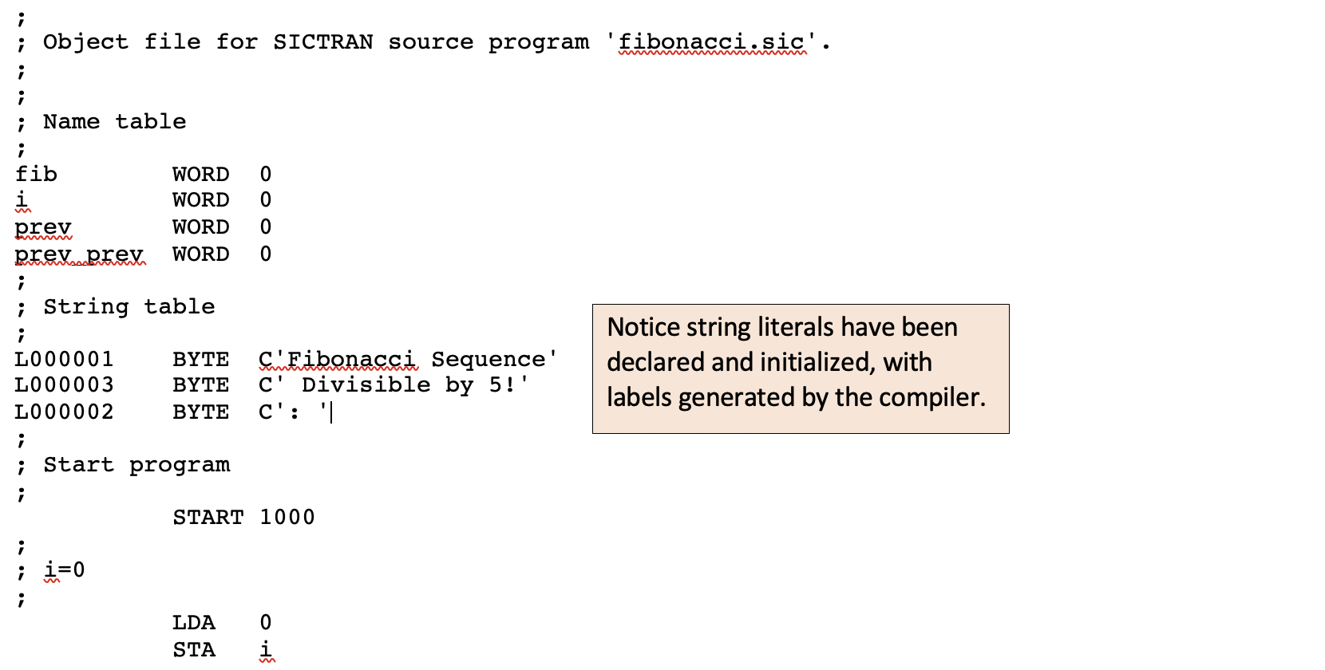
Generated Code

Slide 23
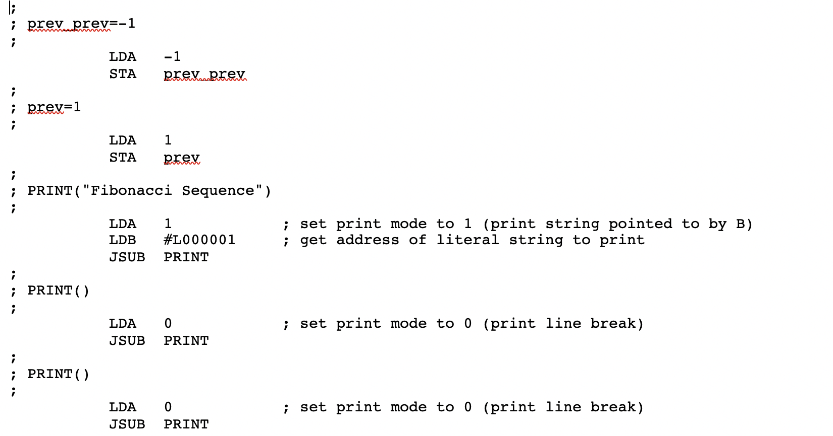
Generated Code

Slide 24
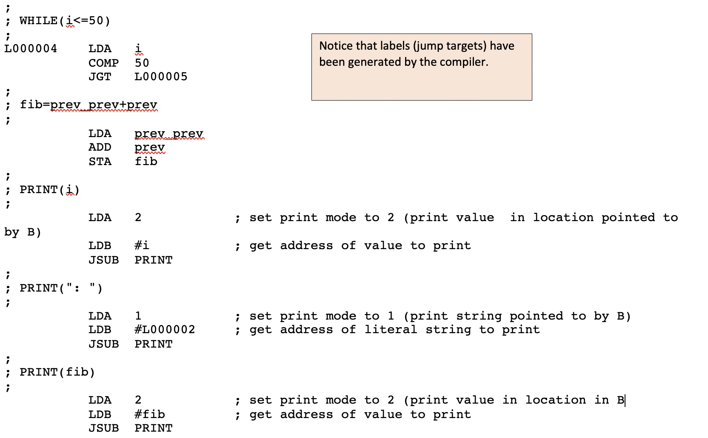
Generated Code

Slide 25
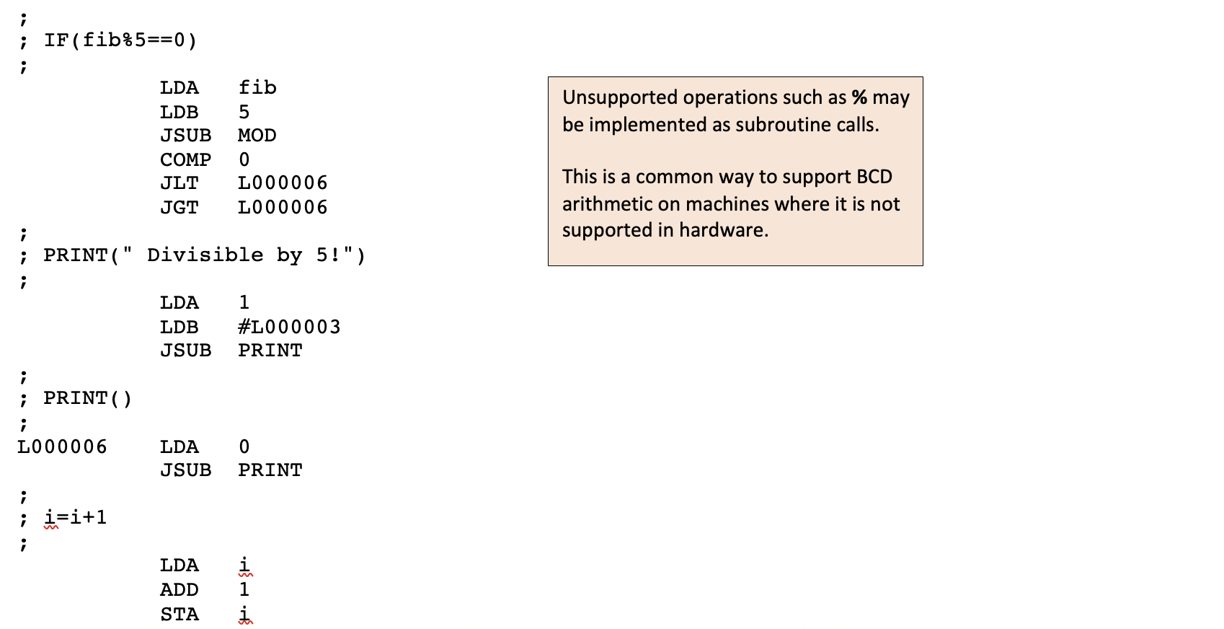
Generated Code

Slide 26
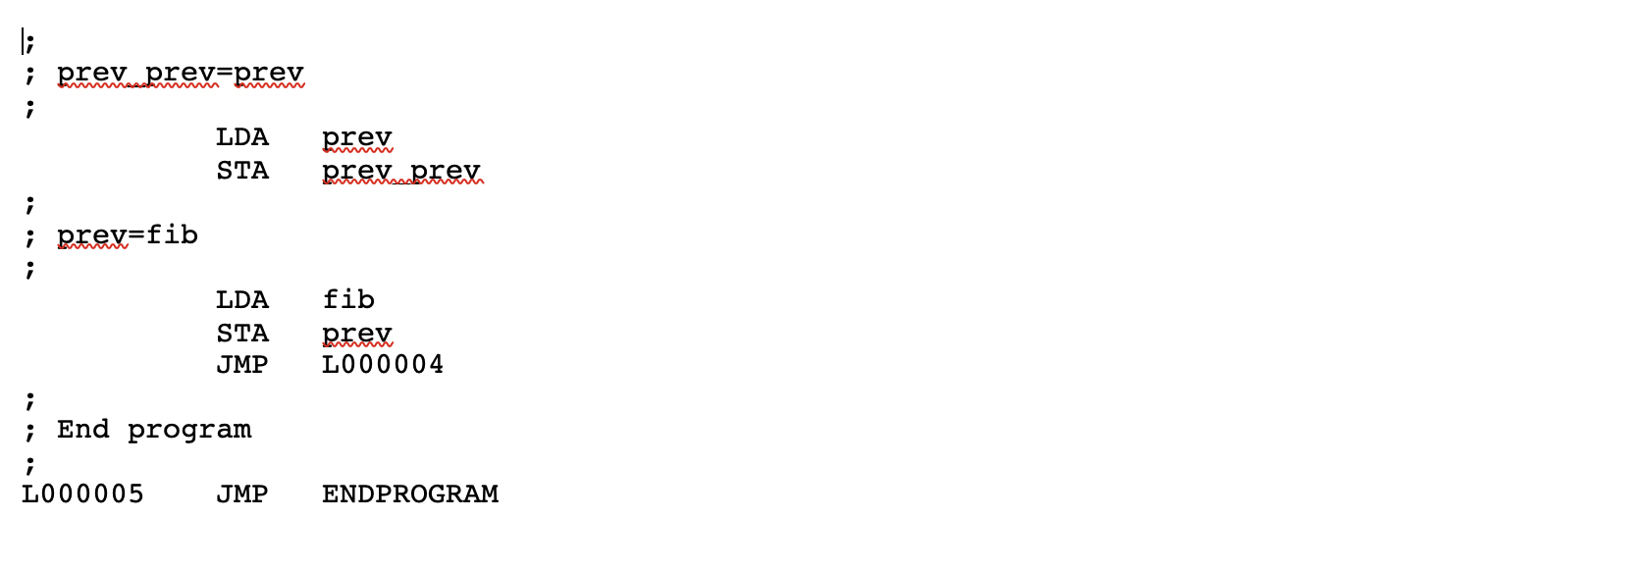
Generated Code

Slide 27
Code Generation: Local Data
This is a machine dependent compiler feature
Data may be stored with the subroutine code – but it will be overwritten if the subroutine calls itself (recursion)
Subroutine
Local Variables
Subroutine
Code

Slide 28
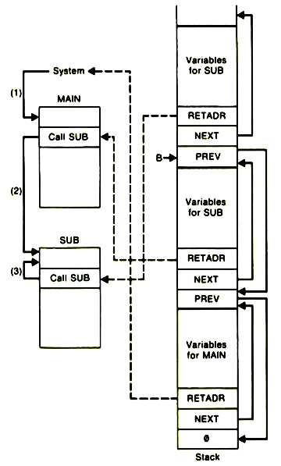
Code Generation: Local Data & Recursion
This is a machine dependent compiler feature
Many languages save subroutine arguments, local variable instances, and the return address each time a subroutine is called
Necessary for recursion
The best mechanism for doing this is a stack
Each time a subroutine is called, arguments are placed on the stack, and space is allocated for local variables
Code needs to be emitted at the start and the end of a subroutine to handle this

Slide 29
Code Generation: The Stack
When contained in a subroutine, variable references are not fixed – we cannot simply pass the labels through to the assembler
Local variables need to be “flagged” in the symbol table
Address references for local variables are relative to the stack pointer
Accomplishing this depends on the addressing modes available on the underlying machine

Slide 30
Code Optimizations: Register Allocation
Register allocation is a machine dependent code optimization
Registers are faster than memory – so we want to make effective use of them!
Optimizing registers requires knowledge of the machine architecture
The code generator must have a register allocation function to keep track of which registers are in use as the parse tree is walked and code is generated

Slide 31
Code Optimizations: Register Allocation
Reduce Memory Accesses by Eliminating Redundant Loads/Stores
OldInventory = Inventory;
Inventory = Inventory – Sales;
Unoptimized |  | Optimized
LDA | Inventory | LDA | Inventory
STA | OldInventory | STA | OldInventory
LDA | Inventory
SUB | Sales | SUB | Sales
STA | Inventory | STA | Inventory

Slide 32
Code Optimizations: Register Allocation
One Register versus Multiple Registers if (expression1 == expression2)
One Register | Multiple Registers
Evaluate expression1 and return result in A Store A in a temporary memory location Evaluate expression2 and return result in A Compare A to the temporary memory location | Evaluate expression1 and return result in A Evaluate expression2 and return result in B Compare A to B
The Code Generator makes use of a register allocation function to keep track of what’s in each register, and which are available for use

Slide 33
Code Optimizations: Register Allocation
Use Registers for Most Frequently Accessed Data
Within each code block (single-entry, single exit)
Load data into registers when entering block, store when exiting block
Determine most-referenced data locations
Keep the values of those locations in registers

Slide 34
Code Optimizations: Register Allocation
Optimize Register Usage in Inner Loops
Programs spend most of their time in “inner loops”
The register allocation function should place a higher emphasis on register usage as nesting depth increases
Optimization doesn’t always make the right decisions!
A deeply-nested inner loop that is executed three times is less critical than an outer loop that is executed 1,000 times

Slide 35
Code Optimizations: Invariant Code
This is a machine independent code optimization
Invariant Code Optimization: computations that do not change should be removed from loops: for (index = 0; index < max-1; index++ ) { if (array[index] > array[index+1] { temp = array[index]; array[index] = array[index+1]; array[index+1] = temp; } }

Slide 36
Code Optimizations: Invariant Code
Invariant Code Optimization: the optimized assembly language would be equivalent to: stop = max-1; for (index = 0; index < stop; index++ ) { if (array[index] > array[index+1] { temp = array[index]; array[index] = array[index+1]; array[index+1] = temp; } }

Slide 37
Compiler Output Options
High Level Language Source Code (e.g. C++)
Scanner (lexical analyzer)
Tokens (types & values)
Parser (syntax analyzer)
Parse Tree (an internal representation of the program)
Assembly Language Source File
Abstract
(P-code)
Language Source File
Code Generator
Code Generator
- OR -
- OR -
Interpreter

Slide 38
Compiler Output Options: Assembly
The original – and still the primary – purpose of a high-level language compiler is to convert the high-level code to assembly language for a particular machine
There are other options that can be considered for different purposes

Slide 39
Compiler Output Options: P-code
P-code: precompiled code, or portable code, or Pascal code
Assembly language code for an abstract (hypothetical) machine
P-code may be interpreted
P-code may be translated into an assembly language instruction set for the current machine
P-code may be “compiled” on the fly to machine code
Since P-code interpreters and translators exist on any machine, writing a compiler that emits p-code is a quick way to achieve language portability

Slide 40
Building Software
High Level Language Source Code (e.g. C++)
P-Code Source Code
Assembly Language Source Code
Compiler
Translator
Machine Code
JIT Compiler
Interpreter

Slide 41
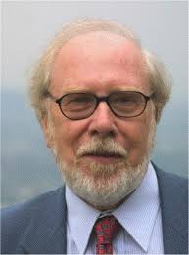
Compiler Output Options: P-code Examples
P-code: may also refer to Pascal code – an early portable layer
PASCAL – 1970 – created by Swiss computer scientist Nicklaus Wirth as a highly structured instructional language; quickly replaced ALGOL as the teaching language of choice
First P-code emitter - 1973
UCSD P-Machine – 1977 – widely used in academia, as well as commercially

Slide 42

Compiler Output Options: P-code Examples
JVM (Java Virtual Machine): a virtual machine built by James Gosling and Brendan Eich – 1995 – specifically for Java - but now widely used
Virtual machine instruction set
Manages memory and system resources

Slide 43
Interpreters
Early interpreters (e.g. BASIC – 1964): Line-by-line scanning, parsing and interpreting
Modern Approaches
Scan and Parse entire program – generate parse tree
Interpret parse tree rather than source code
Compile on-the-fly – as each line or statement is encountered, scan it, parse it, and generate code.
Great for optimizing loop performance

Slide 44
Pure Interpreters Are Applications
A traditional interpreter is not “system software”
They don’t produce executable code
They don’t have system dependencies
They simply perform operations that are described to them in a high-level programming language

Slide 45
Really? Just an Application?
Write a calculator application that accepts keyboard input - any string of numbers separated by operators – and prints the result: 15.3 / 12.77 + 0.8 * 87
You could write that application. You might write a scanner to break the input down into tokens
Now let’s add the ability to group operations: 17.4 * (18.2 – 3.0) + (7.77 / 8.9)
Maybe at this point you’ll write a parser to break down the elements and build a tree structure that you can walk to actually perform the operations

Slide 46
Yes. Just an Application.
Now let’s add the idea of variables, so we can store and reuse values: savethis = 17.4 * (18.2 – 3.0) + (7.77 / 8.9) result = 0.15 * savethis
You can parse this into a parse tree, and walk the tree to perform the operations.
You’ll need to create a data structure to save the contents of the variables
But it’s still just an application!
It doesn’t generate code
It isn’t system dependent
Variable Name | Contents
savethis | 265.353
result | 39.802

Slide 47
Interpreted Languages Can Be Very Rich
We started with a simple calculator, added grouped expressions, and then assignments and variables.
We can continue to add features:
Type declarations
While loops
If/then/else statements
Functions and function calls
The process of writing an interpreter is the same:
scanner
parser
Executer (walks the tree and executes instructions)

Slide 48
Interpreting a Parse Tree
(ANIMATE)
function processVariable( node ) {
variableName = getValue( node );
return getContents( variableName );
}
function processExpression( node = 3 ) {
leftValue = processVariable(4);
rightValue = processVariable(6);
Variable Name | Contents
Inventory | 345
Sales | 22
3
Expression
4
Variable
5
Operator
6
Variable
Inventory
-
Sales

Slide 49
Interpreting a Parse Tree
function processExpression( node = 3 ) {
leftValue = processVariable(4);
rightValue = processVariable(6);
switch ( getValue(5) ) {
case ‘-’:
result = left - right;
return result;
3
Expression
4
Variable
5
Operator
6
Variable
Inventory
-
Sales

Slide 50
Why Write an Interpreter?
Easy to Use / Great for Beginners
BASIC (Beginner’s All-Purpose Symbolic Instruction Code) – 1964 – created as an easy-to-use teaching language, which became popular due to its simplicity
Immediate syntax checking
Immediate execution – doesn’t require a complicated build process

Slide 51
Why Write an Interpreter?
Portability!
Allows languages to be run on any operating system and any architecture without writing a compiler
PHP – 1995 – now the most widely used language for web applications.
JavaScript – 1995 – embedded in web browsers on a wide range of platforms. Portability is integral to the very concept of Javascript.

Slide 52
PHP and Facebook: Case Study
Facebook was originally written in PHP
To improve performance, Facebook adopted the HipHop translator in 2010, which translated the php code to C++ (which was then compiled)
The compiled C++ code improved performance by a factor of two
Issues: some PHP language constructs did not translate well with HipHop
In 2013, Facebook switched to the HipHop Virtual Machine (HHVM), a p-code abstract machine.
PHP code is compiled into the HHVM instruction set
HHVM instructions are compiled on demand into machine code
New code being written in Hack, a strongly-typed PHP-like language

Slide 53
PHP and Facebook: the Takeaway
There are a range of technologies today that can be used for software development and production operations:
Macro Processors
Compilers
Cross-compilers
Language Translators
Assemblers
Interpreters
IDEs & Debuggers
Just-In-Time Compilers
Key software concepts provide a basis for all of these technologies:
Lexical analysis (scanning)
Syntax analysis (parsing)
Formal grammars
Sematic processing
Code generation
Interpreting

Slide 54
For Next Week
Log in to Canvas and complete Assignment 5

